Slide 1

OpenAI API
Responses
One

Slide 2
Looking at the Differences
model
messages input
response_format text
temperature
stream
max_completion_tokens max_output_tokens
stop
top_p
frequency_penalty
presence_penalty
Notes:
from openai import OpenAI
client = OpenAI()

Slide 3
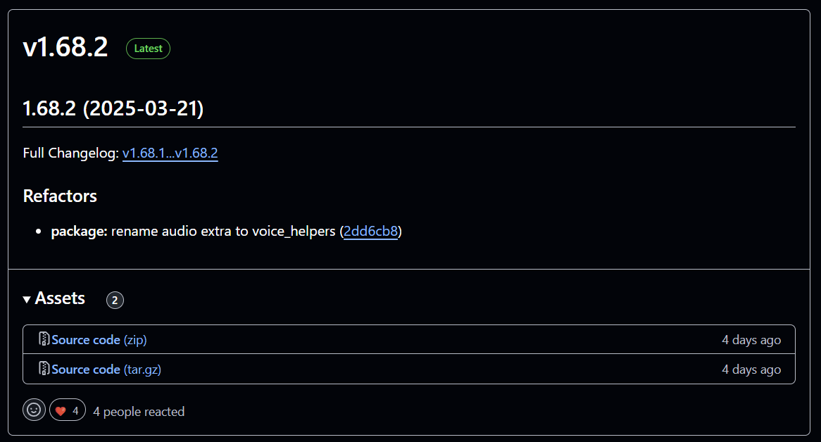
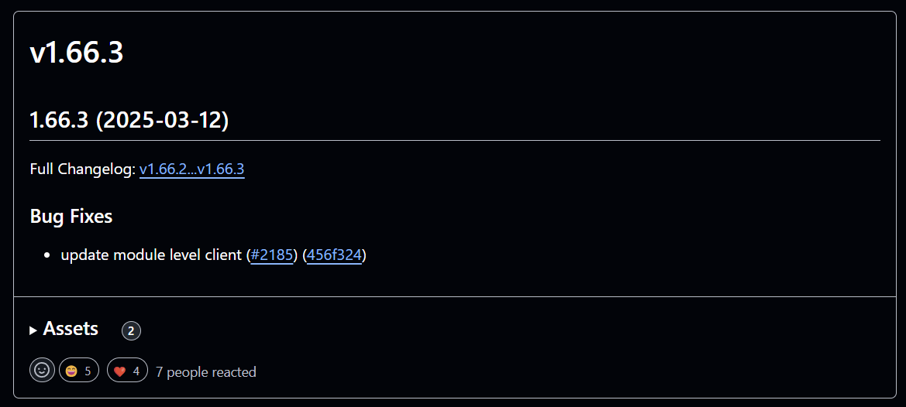
Time to Upgrade!
Notes:
https://github.com/openai/openai-python/releases

Slide 4
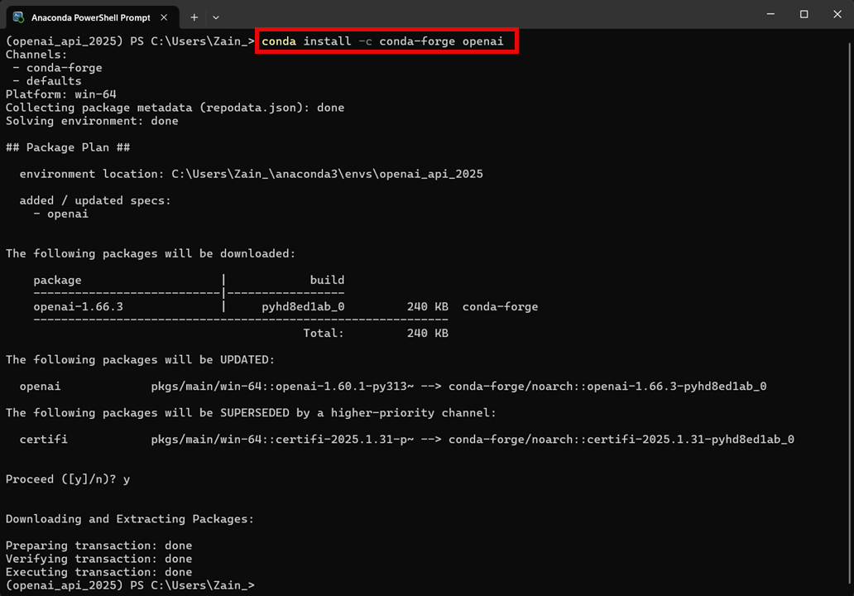
Notes:
conda list openai
conda install -c conda-forge openai

Slide 5
DEMO: Updating the OpenAI API Python Package
Notes:
conda list openai
conda search -c conda-forge openai
conda install -c conda-forge openai

Slide 6
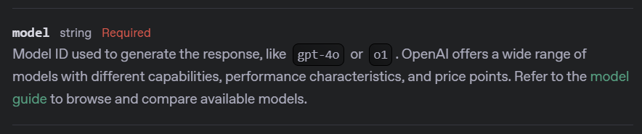
Notes:
https://platform.openai.com/docs/api-reference/responses/create#responses-create-model

Slide 7
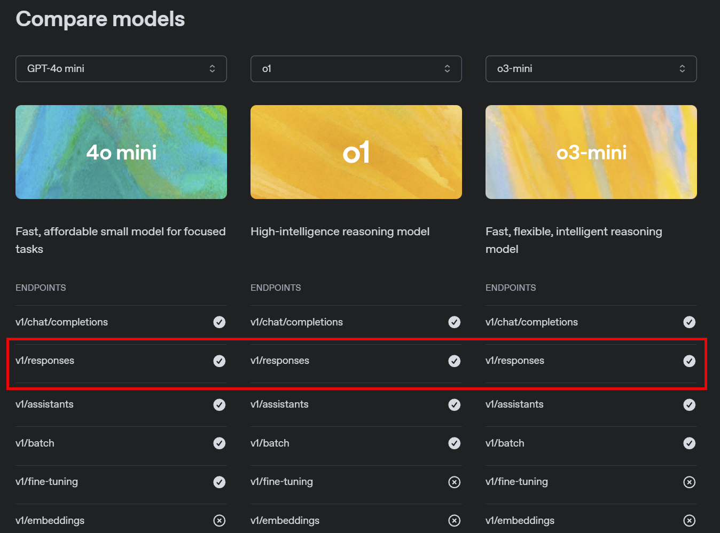
Notes:
https://platform.openai.com/docs/models#model-endpoint-compatibility

Slide 8
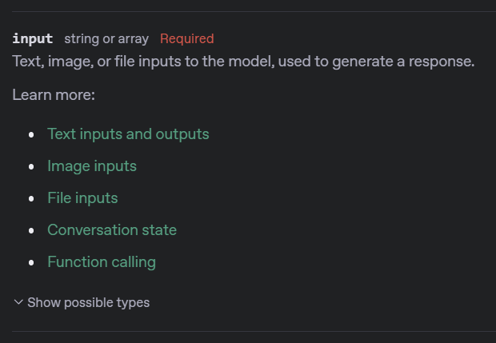
Notes:
https://platform.openai.com/docs/api-reference/responses/create#responses-create-input

Slide 9
Python Package
from openai import OpenAI
client = OpenAI()
Connection to the API
Notes:
from openai import OpenAI
client = OpenAI()
import json

Slide 10
Variable
Conn
Endpoint
Cmd
completion = client.responses.create(
model="gpt-4o-mini",
input=[
{"role": “developer", "content": "You are a helpful assistant."},
{"role": "user", "content": "Write a haiku about recursion in programming."}
]
)
Parameter
Argument
Notes:
response = client.responses.create(
model="gpt-4o-mini",
input=[
{"role": "system", "content": "You are a helpful assistant."},
{"role": "user", "content": "Write a haiku about recursion in programming."}
]
)
print(response.output_text)

Slide 11
DEMO: Required Parameters

Slide 12




Notes:
https://www.youtube.com/channel/UC35ZpwldGw7ZJ5R-2sLijzw

Slide 13
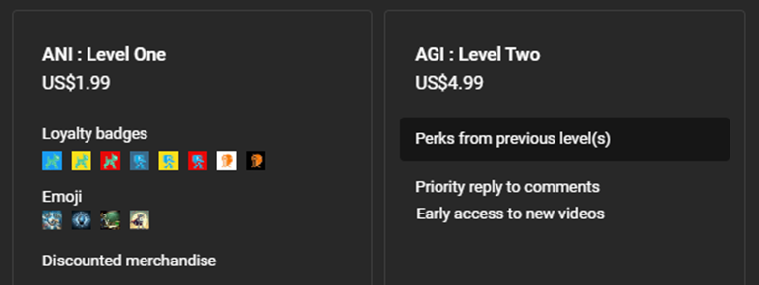

Notes:
https://www.youtube.com/@reallyeasyai/join

Slide 14

https://shop.reallyeasy.ai
Notes:
https://shop.reallyeasy.ai

Slide 15

https://www.youtube.com/@ainewsfresh
Notes:
https://www.youtube.com/@ainewsfresh

Slide 16

https://www.youtube.com/@aipaperspodcastdaily
Notes:
https://www.youtube.com/@aipaperspodcastdaily

Slide 17
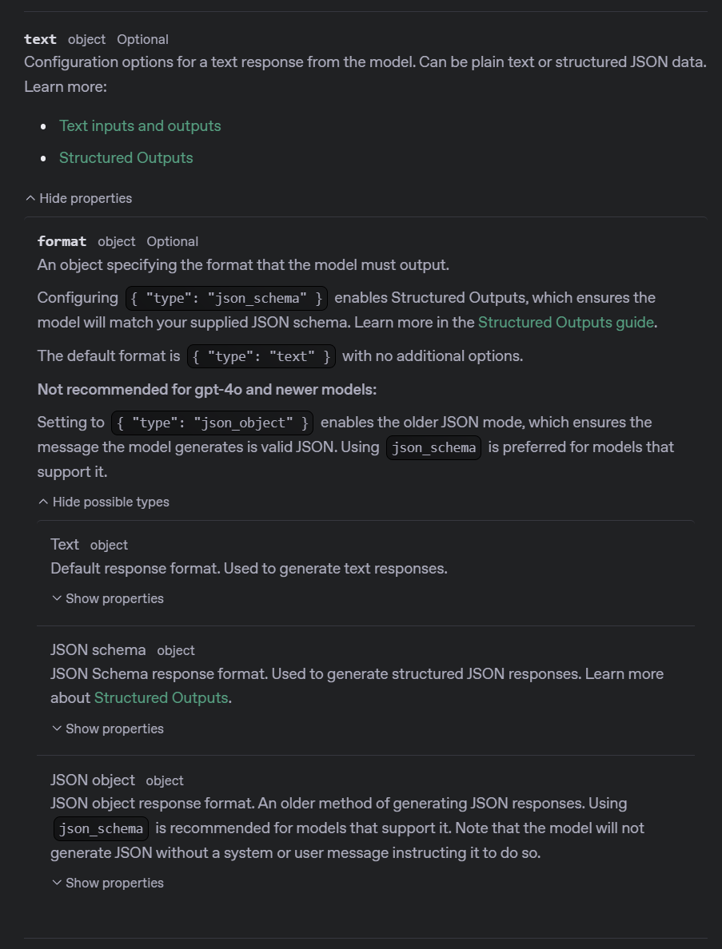
Notes:
https://platform.openai.com/docs/api-reference/responses/create#responses-create-text

Slide 18
response = client.responses.create(
model="gpt-4o-mini",
input=[
{"role": "developer", "content": "You are a helpful assistant."},
{"role": "user", "content": "Write a haiku about recursion in programming."}
],
text={"format": {"type": "text"}},
)

Slide 19
DEMO: Response Formats

Slide 20
OpenAI API
Responses
One

